Slide 1
Problem Statement 3
Solved by Team: Error 404

Slide 2
Objective
The objective of this problem is to leverage technology and a web application to enhance child development monitoring, accessibility, and support, with a focus on reaching remote areas and providing multi-lingual and user-friendly services. The ultimate goal is to ensure that children receive timely support and assistance, especially those with developmental delays or disabilities.

Slide 3
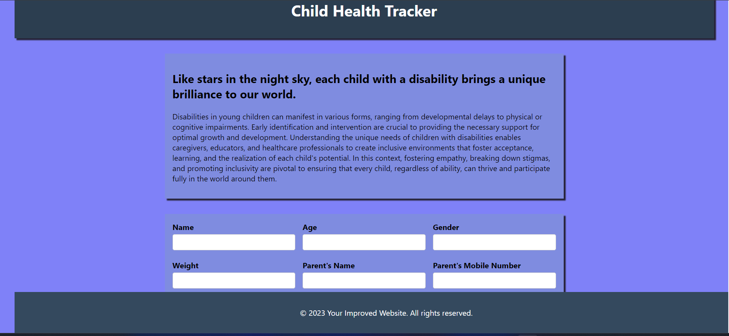

Slide 4
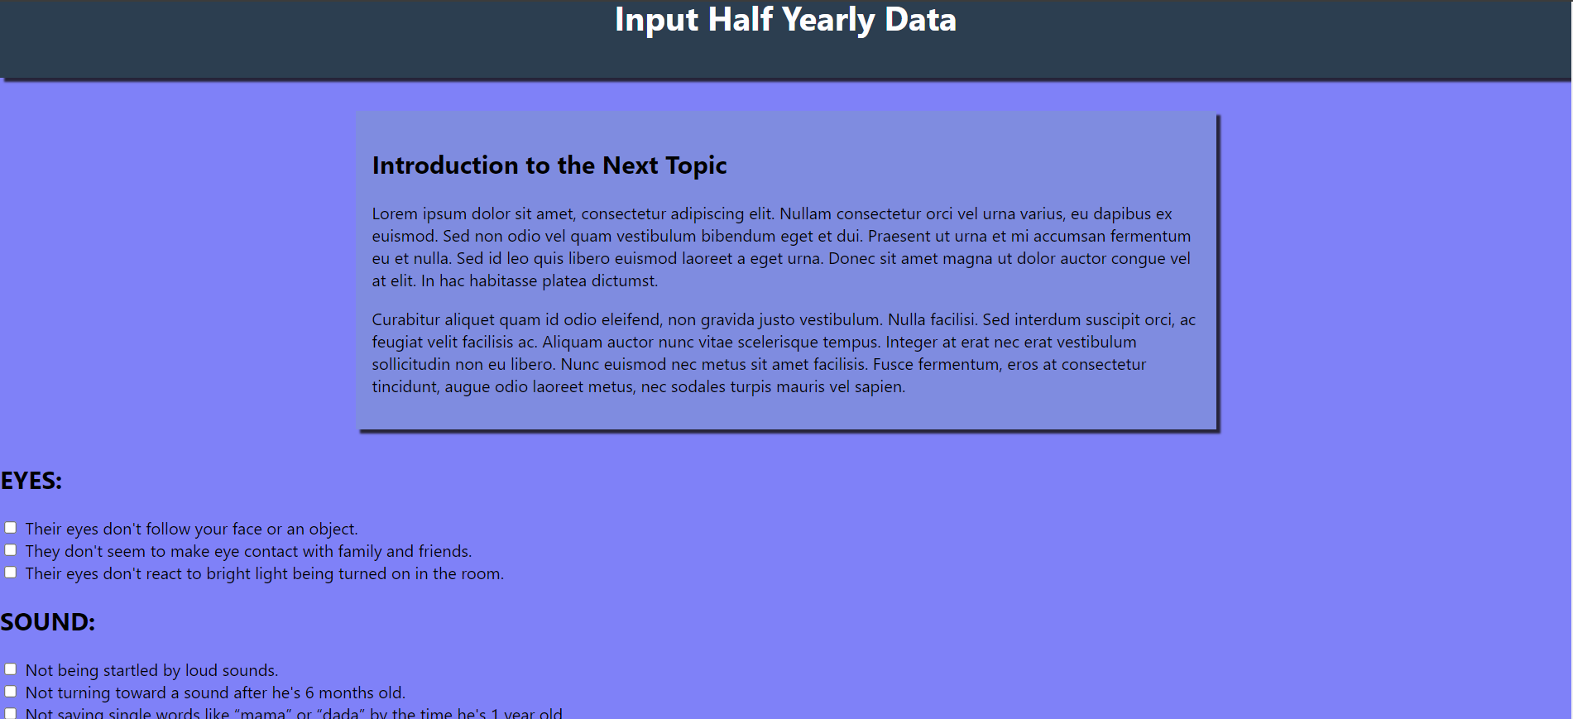

Slide 5
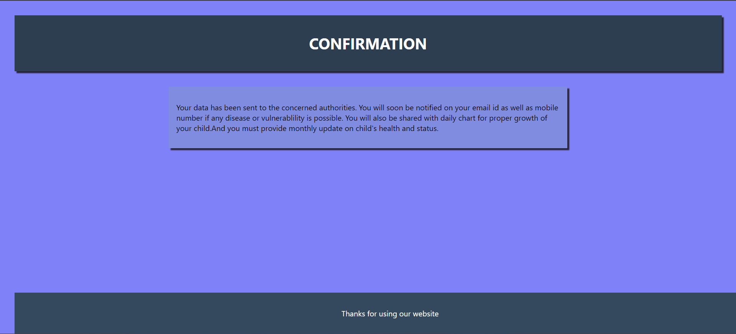

Slide 6
Learnings
As we,first year students at pec Chandigarh, participated in our first-ever hackathon, we tried , learned, and implemented our first website, though we couldn’t do much in the backend part.
PS please watch pokemon

Slide 7
Thank You
Team: Error 404
Lead-Suryanshu
Gem-1-Tanush
Gem-2-Aaryan

